Slide 1

MASTER THE TIDYVERSE
Mike K Smith
Winter 2020
Materials used in this course are derived from
https://github.com/rstudio-education/master-the-tidyverse/
and are shared under a CC-BY-SA-4.0 license.

Slide 2


HELLO
my name is
Mike
 @MikeKSmith
MikeKSmith
Mike.K.Smith@Pfizer.com
CC BY-SA RStudio
Notes:
* introduce yourself

Slide 3
Introduction and Visualize Data | 17th Jan
Transforming (subsetting) data | 24th Jan
Importing and reshaping data | 31st Jan
Data Types: strings, factors, date-times | 7th Feb
Iteration & Modelling | 14th Feb
Reproducible reporting | 21st Feb
CC BY-SA RStudio

Slide 4
References & resources

Slide 5
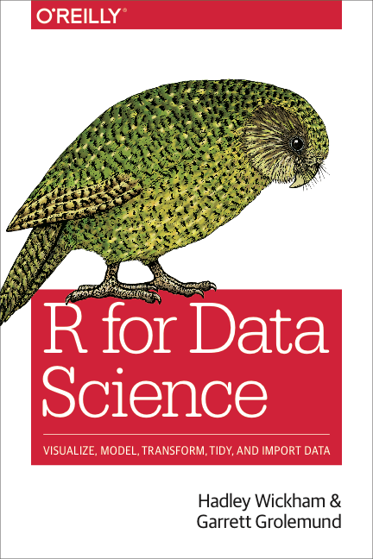
Accompanying book for this course.
Very readable
Covers all the material from the course and more.
Read online at https://r4ds.had.co.nz/
CC BY-SA RStudio

Slide 6
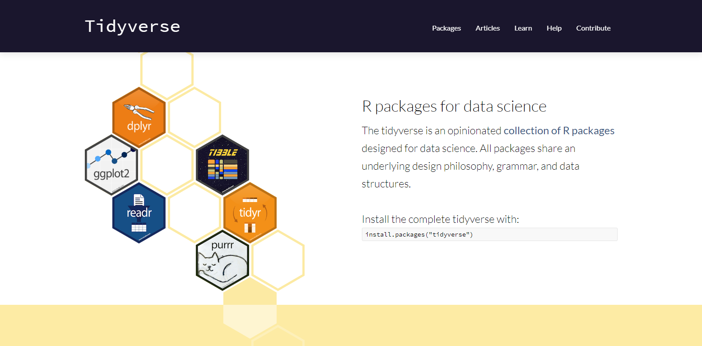
Reference material for all tidyverse packages
http://tidyverse.org
CC BY-SA RStudio

Slide 7
Introduction to
R & RStudio

Slide 8

What is ?

Slide 9
Statistical programming language

Slide 10
Statistical programming language

Slide 11
Statistical programming language

Slide 12
Why

Slide 13
Why not Python,
SAS,
Julia,
Stan,
…

Slide 14
and Python,
SAS,
Julia,
Stan,
…

Slide 15
Collect
Data
The (data) scientific method
Design Experiment
Explore or Test
Form Hypothesis
Communicate Results
CC BY-SA RStudio
Notes:
But let’s take a moment to remind ourselves about how science works…
We first form a hypothesis, we use this to drive a particular experimental design
We collect data
We then analyse this data
And finally we should communicate our results with others in order to move forward science.

Slide 16
Import data into software
Collect
Data
Tidy data into useable form
Design Experiment
Explore or Test
Form Hypothesis
Transform the data. Do feature engineering.
Deploy app or publish paper
Write code to apply a modeling algorithm.
Build app or write paper
Visualize the data and/or results
Communicate Results
CC BY-SA RStudio
Notes:
But there’s actually a bunch of other steps involved in between each of these, and I’m showing just a few of them here
The key thing here is that *these* steps are the kinds of thing that you can use R and the tidyverse to help you with.

Slide 17
(Applied) Data Science
Import data into software
Collect
Data
Tidy data into useable form
Design Experiment
Explore or Test
Visualize
Form Hypothesis
Transform the data. Do feature engineering.
Import
Tidy
Model
Communicate
Transform
Deploy app or publish paper
Write code to apply a modeling algorithm.
Program
Build app or write paper
Visualize the data and/or results
Communicate Results
CC BY-SA RStudio
Notes:
So when you take these steps and collapse them you get a model for what we can call applied data science

Slide 18
Meet the tools:
R and RStudio

Slide 19
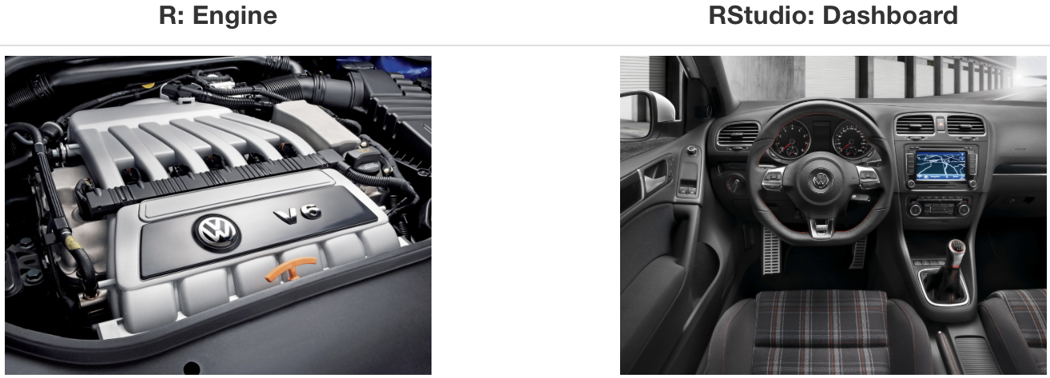
What is RStudio?
Source: Modern Dive

Slide 20
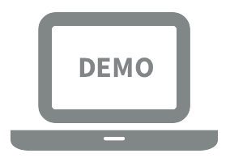
Let’s take a tour - R / RStudio

Slide 21
Concepts introduced:
Console
Saving sequences of commands in an R script
Using R as a calculator
Environment
Loading and viewing a data frame
Accessing a variable in a data frame
R functions

Slide 22
R (absolute) basics
Most things are functions:
do_this(to_this) do_that(to_this, with_these_arguments)
Assign results to an object:
myObject <- 2 * 2

Slide 23
R Packages

Slide 24




help
help
help
help
help
help
help
help
help
function1()
function2()
function3()
function4()
function4()
function5()
function6()
function7()
function7()
function8()
function9()
function10()
function11()
“base R”
R “Packages”
CC BY-SA RStudio

Slide 25
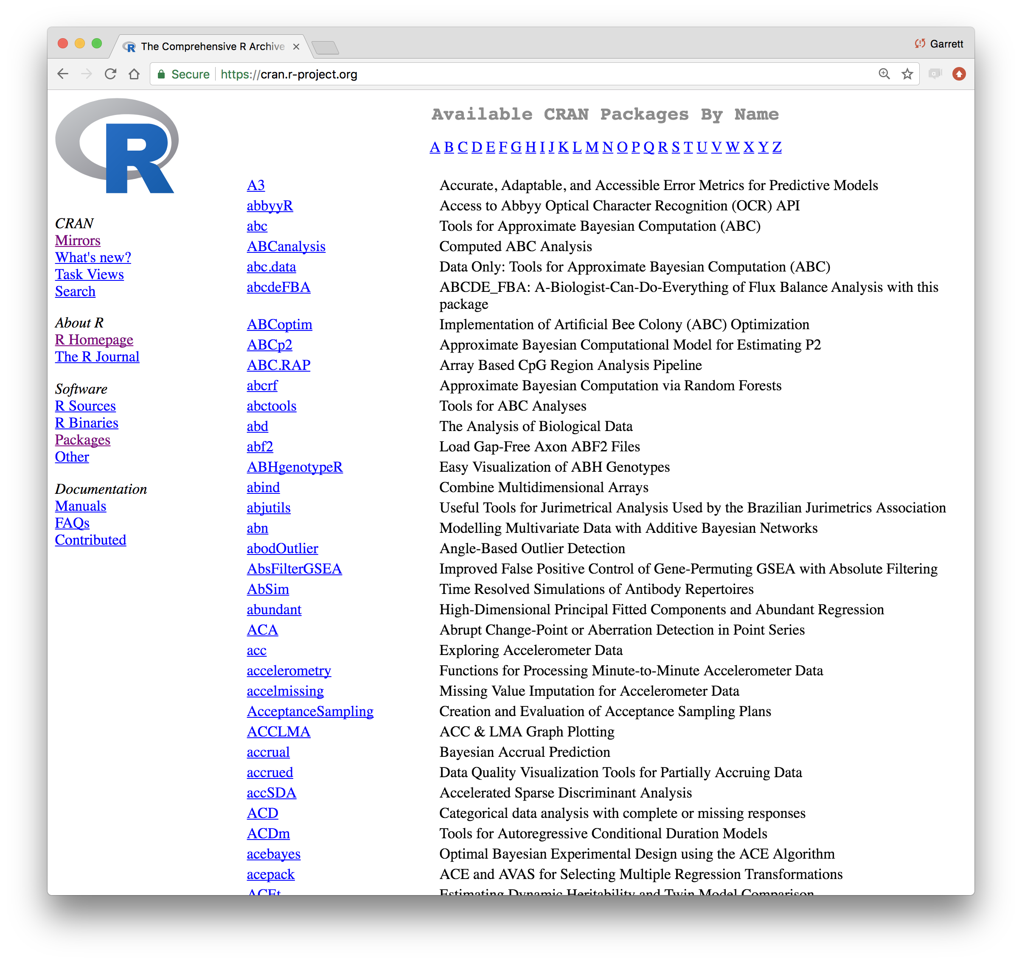
CC BY-SA RStudio

Slide 26
Using packages
1
2
install.packages("foo")
library("foo")
Downloads files to computer
Loads package
1 x per computer
1 x per R Session
CC BY-SA RStudio

Slide 27
The Tidyverse

Slide 28
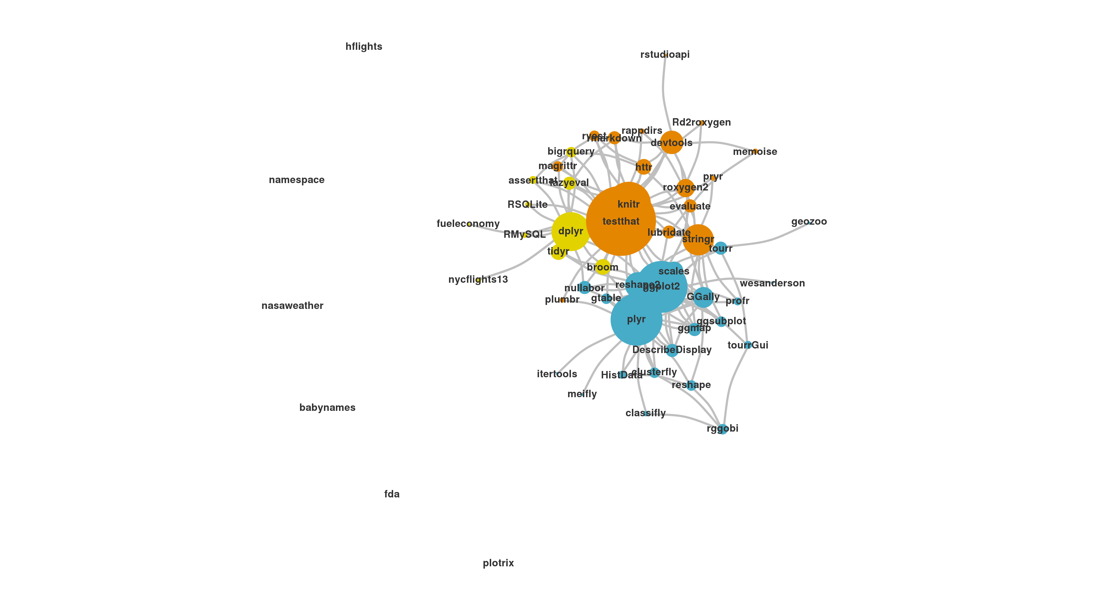
The Tidyverse
A collection of modern R packages that share common philosophies, embed best practices, and are designed to work together.
Display by Adolfo A ́lvarez
CC BY-SA RStudio

Slide 29
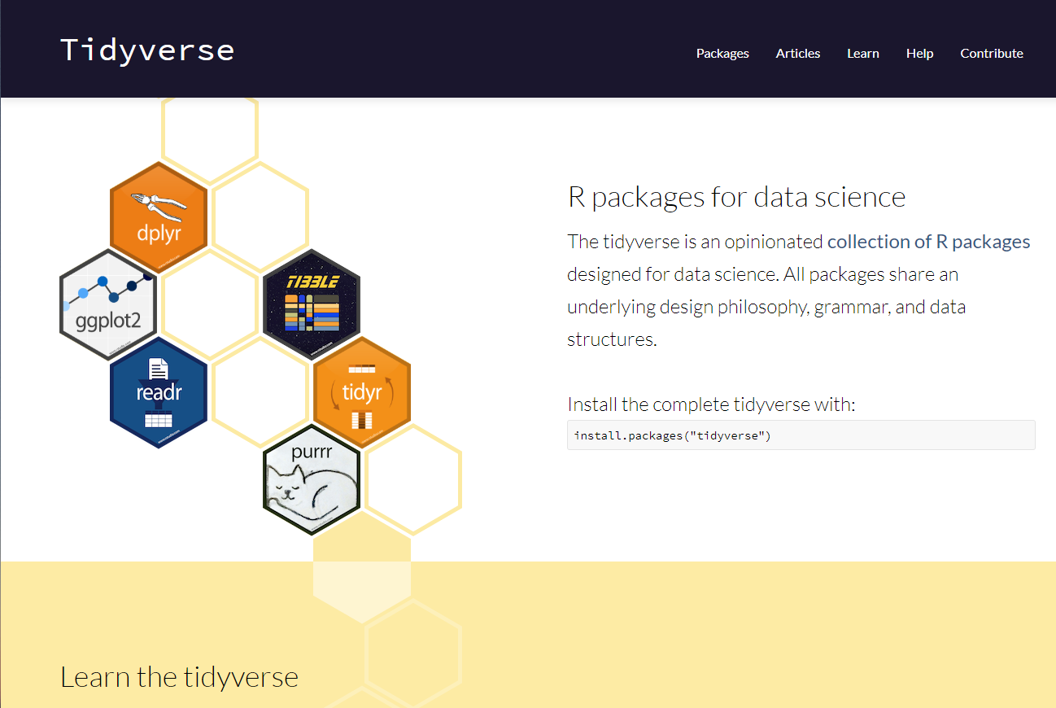
tidyverse.org
CC BY-SA RStudio

Slide 30
tidyverse
An R package that serves as a short cut for installing and loading the components of the tidyverse.
library("tidyverse")
CC BY-SA RStudio

Slide 31
install.packages("tidyverse")
does the equivalent of
install.packages("ggplot2")
install.packages("dplyr")
install.packages("tidyr")
install.packages("readr")
install.packages("purrr")
install.packages("tibble")
install.packages("hms")
install.packages("stringr")
install.packages("lubridate")
install.packages("forcats")
install.packages("DBI")
install.packages("haven")
install.packages("httr")
install.packages("jsonlite")
install.packages("readxl")
install.packages("rvest")
install.packages("xml2")
install.packages("modelr")
install.packages("broom")
CC BY-SA RStudio

Slide 32
install.packages("tidyverse")
library("tidyverse")
does the equivalent of
does the equivalent of
install.packages("ggplot2")
install.packages("dplyr")
install.packages("tidyr")
install.packages("readr")
install.packages("purrr")
install.packages("tibble")
install.packages("hms")
install.packages("stringr")
install.packages("lubridate")
install.packages("forcats")
install.packages("DBI")
install.packages("haven")
install.packages("httr")
install.packages("jsonlite")
install.packages("readxl")
install.packages("rvest")
install.packages("xml2")
install.packages("modelr")
install.packages("broom")
library("ggplot2")
library("dplyr")
library("tidyr")
library("readr")
library("purrr")
library("tibble")
CC BY-SA RStudio

Slide 33
Tidy tools
Functions are easiest to use when they are:
Simple - They do one thing, and they do it well
Composable - They can be combined with other functions for multi-step operations
Smart - They can use R objects as input.
Tidy functions do these things in a specific way.
CC BY-SA RStudio

Slide 34
Tidy data
Tidy functions all expect and return the same data structure, known as tidy data:
CC BY-SA RStudio

Slide 35

What do you mean by “tidy”?
Notes:
So here’s the crux of the tidy idea (and it’s not too peculiar):
Each variable in a dataset should be in one column.
Each observation should be on a row.
Each cell should represent one value.

Slide 36
Reproducibility

Slide 37
GOAL: Reproducible data analysis

Slide 38
Reproducibility checklist
What does it mean for a data analysis to be “reproducible”?
Near-term goals:
Are the tables and figures reproducible from the code and data?
Does the code actually do what you think it does?
In addition to what was done, is it clear why it was done? (e.g., how were parameter settings chosen?)
Long-term goals:
Can the code be used for other data?
Can you extend the code to do other things?

Slide 39
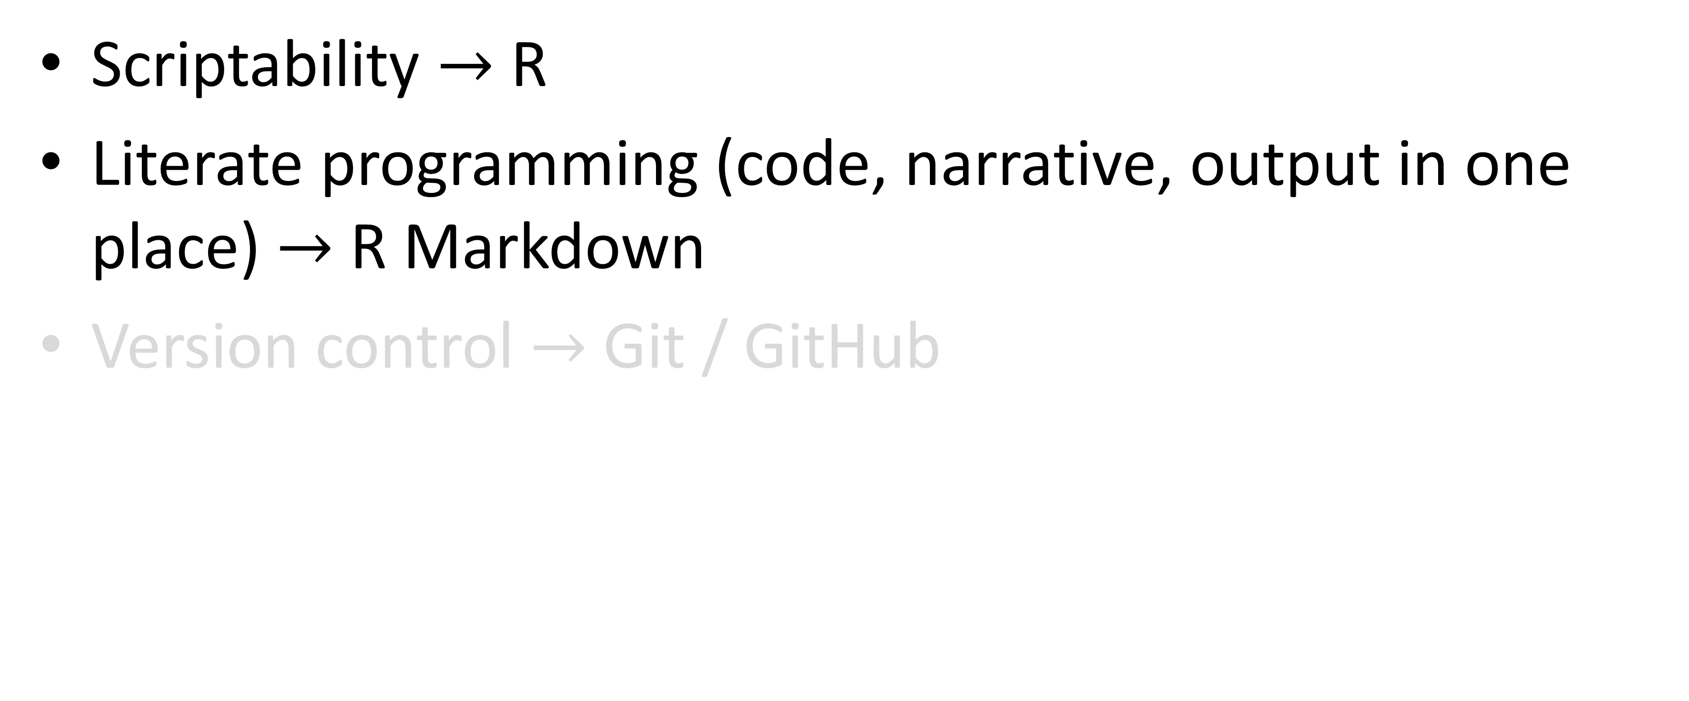
Toolkit
Scriptability $→$ R
Literate programming (code, narrative, output in one place) $→$ R Markdown
Version control $→$ Git / GitHub

Slide 40
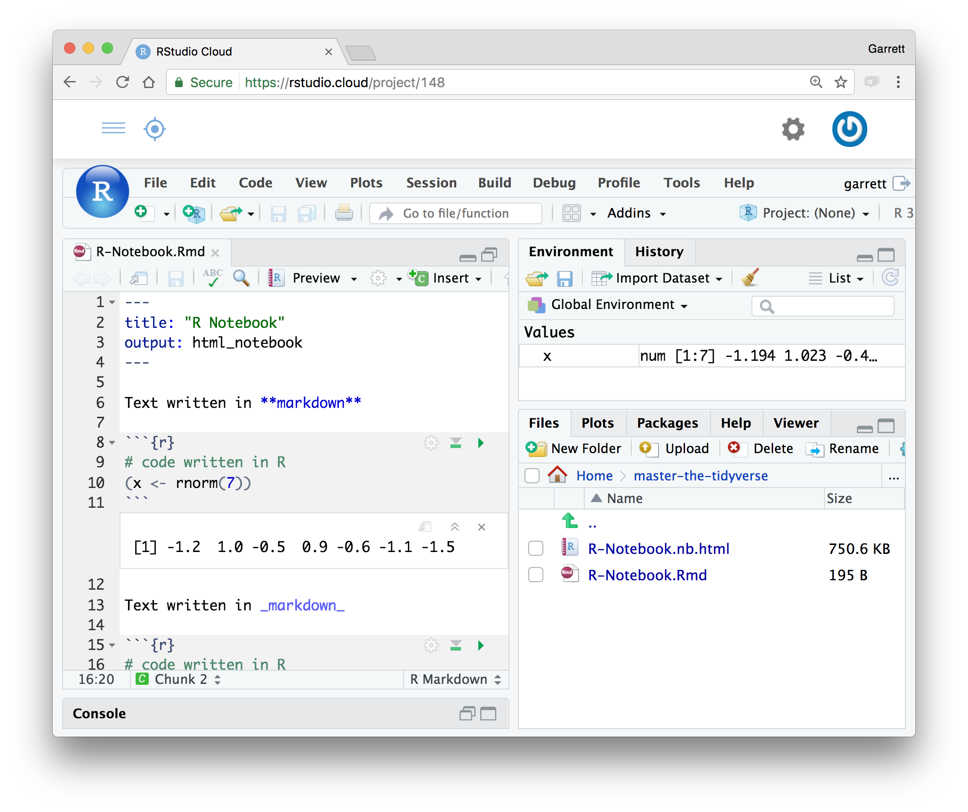
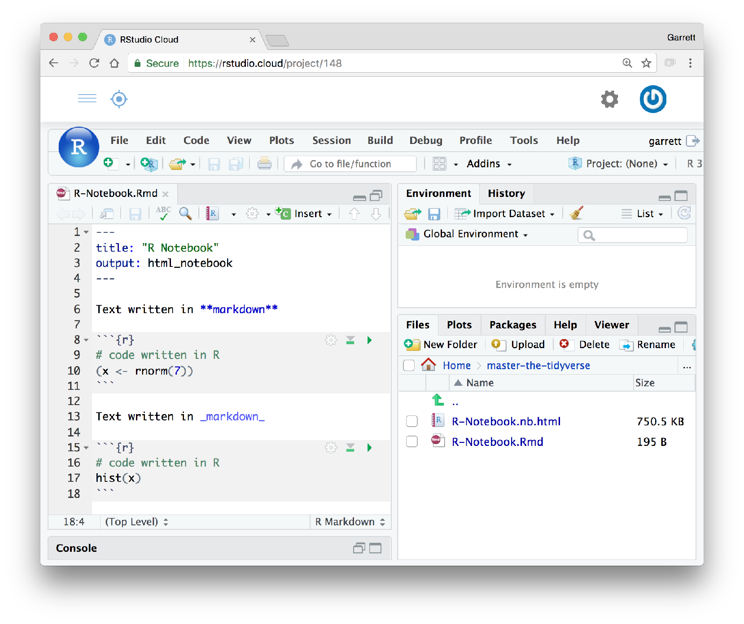
R Notebooks
An authoring format for Data Science.
Click to run all code chunks above
Click to run code in chunk
Code result
CC BY-SA RStudio

Slide 41
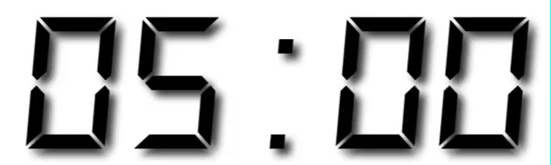
Your Turn
Open /exercises/00-Introduction.Rmd. Read through the notebook and do everything it tells you to do.

